Slide 1

VEHICLE RENTAL WEBSITE
MAJOR PROJECT
UNDER THE GUIDANCE OF
Dr. A.SUBHASHINI M.Sc., M.Phil., M.C.A., Ph.D .,SET,NET
ASSISTANT PROFESSOR
DEPARTMENT OF SOFTWARE SYSTEMS,
PSG COLLEGE OF ARTS & SCIENCE,
COIMBATORE-641014
PRESENTED BY
G.SANJAI(20MSS038)
DEPARTMENT OF SOFTWARE SYSTEMS,
PSG COLLEGE OF ARTS & SCIENCE,
COIMBATORE-641014.

Slide 2
AGENDA
ABSTRACT
EXISTING SYSTEM
PROPOSED SYSTEM
HARDWARE AND SOFTWARE SPECIFICATION
MODULES OF THE PROJECT
DATAFLOW DIAGRAM
E-R DIAGRAM
DATABASE DESIGN
USER INTERFACE DESIGN

Slide 3
ABSTRACT
Vehicle rental website is a software developed to rent cars and bikes online. The Project “Vehicle rental website ” is for users who can have a wide variety of choices to choose a car or bike for their needs in a best price.
A vehicle rental website is an online platform that facilitates the seamless rental of vehicles to users. It serves as an intermediary between vehicle renters and buyers, providing a user-friendly experience to search, select, book, and manage rentals.
The interface of the project work entitled “vehicle rental website” is developed using PHP, HTML, CSS, JavaScript as Frontend and MySQL as Backend.

Slide 4
EXISTING SYSTEM
Difficult to find vehicles according to our needs.
Only limited number of vehicles would be there for consideration.
The existing system was not much interactive and very slow.
The existing system doesn’t provide much information about vehicles. Only, the basic details were available.
Difficult to maintain information about vehicles.

Slide 5
PROPOSED SYSTEM
Easy to find cars for our needs.
More User-Friendly and Better User-Interface.
Genuine details were only posted.
The data is Maintained electronically, it’s easy for a person to update the details, which has overcome the tedious updation in previous system.
This system works faster and accurate

Slide 6
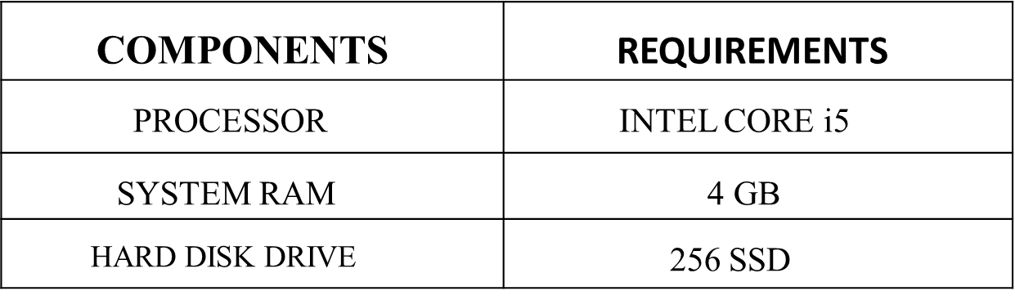
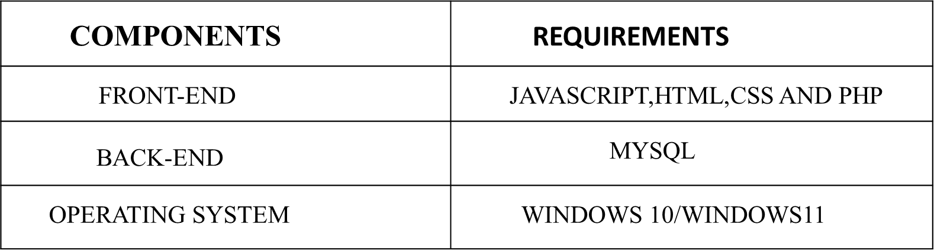
HARDWARE SPECIFICATION:
SOFTWARE SPECIFICATION:

Slide 7
MODULES
ADMIN MODULE:
Dashboard: In this section, admin can see two wheeler and four wheeler vehicle detail in brief.
Brand: In this section, admin can manage brands (Add/Update).
Two Wheeler: In this section, admin can manage two wheeler vehicle (Add/Update).
Four Wheeler: In this section, admin can manage four wheeler vehicle (Add/Update).
Pages: In this section, the admin can manage about us and contact us pages.
Reg Users: In this section, admin can view detail of registered users.
7.Two Wheeler Booking: In this section, admin can view total new booking, total approved booking, total unapproved booking and all booking. Admin has also right to approve and un approved the booking.
8.Four Wheeler Booking: In this section, admin can view total new booking, total approved booking, total unapproved booking and all booking. Admin has also right to approve and un approved the booking.

Slide 8
9. Two Wheeler Report: In this section, admin can views how many booking has been received, counts of booking.
10. Four Wheeler Report: In this section, admin can views how many booking has been received, counts of booking.
11. Search: In this section, admin can search two wheeler and four wheeler vehicle booking by users name and Booking Id.
USERS MODULE:
Home Page: Users can see the listed vehicles on the home page.
About Us: Users can view about us page.
Vehicle: User can view total two wheeler and four wheeler vehicles in details.
Contact us: Users can view the contact us page.
My Booking: In this user can view the detail of booking like status of booking, how much cost will be taken.

Slide 9
DATA FLOW DIAGRAM
LEVEL - 0
Admin
login
Admin_db
LEVEL -1

Slide 10
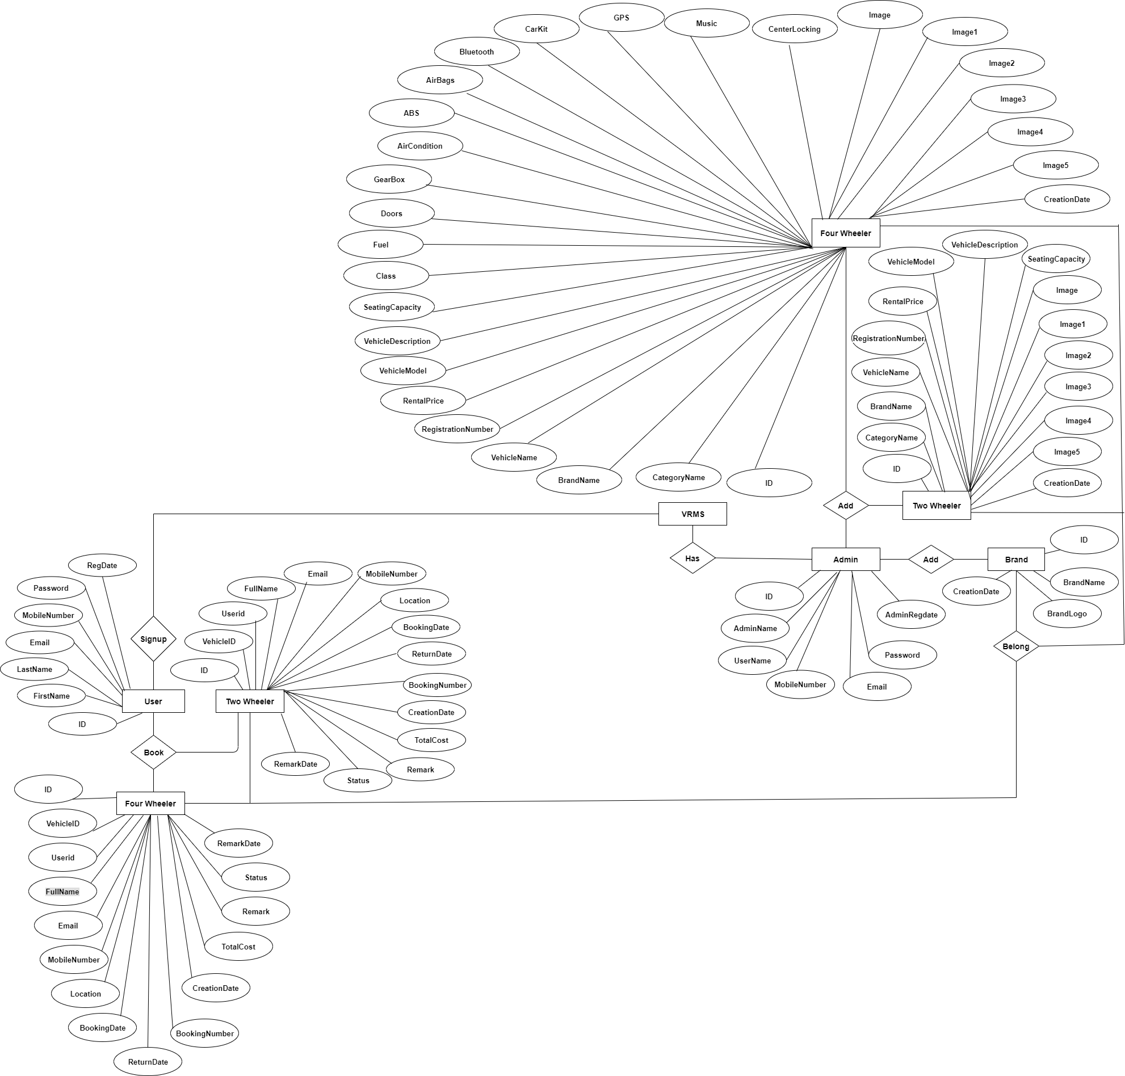
ER DIAGRAM

Slide 11
DATABASE DIAGRAM
TABLE NAME : USER
PRIMARY KEY : User_ID
S.NO | FEILD | DATATYPE | CONSTRAINTS
1 | ID | int(10) | Primary key
2 | FirstName | Varchar(120) | Not null
3 | LastName | Varchar(120) | Not null
4 | Email | Varchar(120) | Not null
5 | MobileNumber | Bigint(20) | Not null
6 | Password | Varchar(120) | Not null

Slide 12
TABLE NAME : Admin PRIMARY KEY : Admin_ID
S.NO | FEILD | DATATYPE | CONSTRAINTS
1 | ID | Int(10) | Primary key
2 | AdminName | Varchar(120) | Not null
3 | Email | Varchar(120) | Not null
4 | Password | Varchar(120) | Not null
5 | MobileNumber | Bigint(10) | Not null

Slide 13
TABLE NAME : Two-wheeler details PRIMARY KEY : ID
S.NO | FIELD | DATATYPE | CONSTRAINTS
1 | ID | Int(10) | Primary key
2 | BrandName | Varchar(120) | Not null
3 | VehicleName | Varchar(120) | Not null
4 | RegistrationNumber | Varchar(120) | Not null
5 | RentalPrice | Varchar(120) | Not null
6 | VehicleModel | Varchar(120) | Not null
7 | VehicleDescription | Varchar(120) | Not null
8 | SeatingCapacity | Int(10) | Not null
9 | Image | Varchar(200) | Not null
10 | Image1 | Varchar(200 | Not null
11 | Image2 | Varchar(200 | Not null
12 | Image3 | Varchar(200 | Not null

Slide 14
TABLE NAME : Four-wheeler details PRIMARY KEY : ID
S.NO | FIELD | DATATYPE | CONSTRAINTS
1 | ID | Int(10) | Primary key
2 | BrandName | Varchar(120) | Not null
3 | VehicleName | Varchar(120) | Not null
4 | RegistrationNumber | Varchar(120) | Not null
5 | RentalPrice | Varchar(120) | Not null
6 | VehicleModel | Varchar(120) | Not null
7 | VehicleDescription | Varchar(120) | Not null
8 | SeatingCapacity | Int(10) | Not null
9 | Image | Varchar(200) | Not null
10 | Image1 | Varchar(200 | Not null
11 | Image2 | Varchar(200 | Not null

Slide 15
S.NO | FIELD | DATATYPE | CONSTRAINTS
13 | Class | Varchar(120) | Not null
14 | Fuel | Varchar(120) | Not null
15 | Doors | Varchar(120) | Not null
16 | GearBox | Varchar(120) | Not null
17 | AirCondition | Varchar(120) | Not null
18 | ABS | Varchar(120) | Not null
19 | AirBags | Varchar(120) | Not null
20 | Bluetooth | Varchar(120) | Not null

Slide 16
TABLE NAME : Brand PRIMARY KEY : Brand_ID
S.NO | FEILD | DATATYPE | CONSTRAINTS
1 | ID | Int(10) | Primary key
2 | BrandName | Varchar(120) | Not null
3 | BrandLogo | Varchar(120) | Not null

Slide 17
TABLE NAME : TwoWheeler booking details PRIMARY KEY : User_ID
S.NO | FIELD | DATATYPE | CONSTRAINTS
1 | ID | Int(10) | Primary key
2 | FullName | Varchar(120) | Not null
3 | Email | Varchar(120) | Not null
4 | MobileNumber | Bigint(10) | Not null
5 | Location | Varchar(120) | Not null
6 | BokkingDate | Varchar(120) | Not null
7 | ReturnDate | Varchar(120) | Not null
8 | TotalCost | Varchar(120) | Not null
9 | Status | Varchar(120) | Not null

Slide 18
TABLE NAME : FourWheeler booking details PRIMARY KEY : User_ID
S.NO | FIELD | DATATYPE | CONSTRAINTS
1 | ID | Int(10) | Primary key
2 | FullName | Varchar(120) | Not null
3 | Email | Varchar(120) | Not null
4 | MobileNumber | Bigint(10) | Not null
5 | Location | Varchar(120) | Not null
6 | BokkingDate | Varchar(120) | Not null
7 | ReturnDate | Varchar(120) | Not null
8 | TotalCost | Varchar(120) | Not null
9 | Status | Varchar(120) | Not null

Slide 19
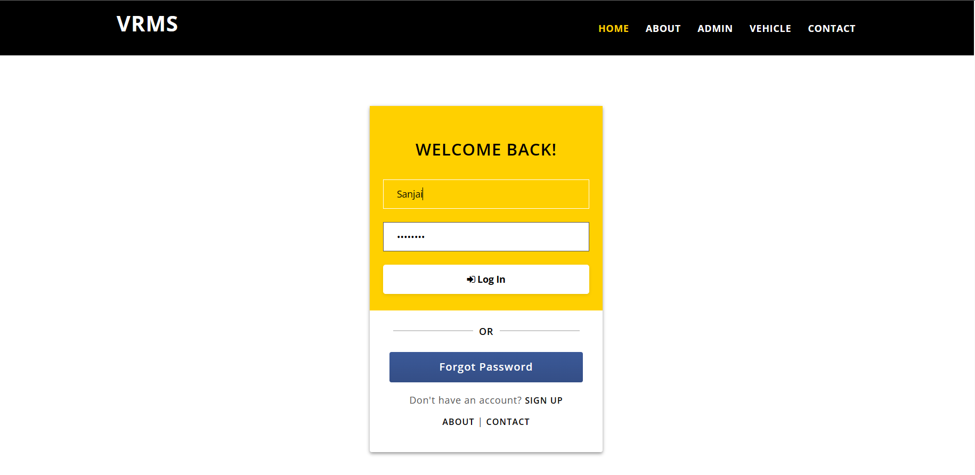
LOGIN PAGE

Slide 20
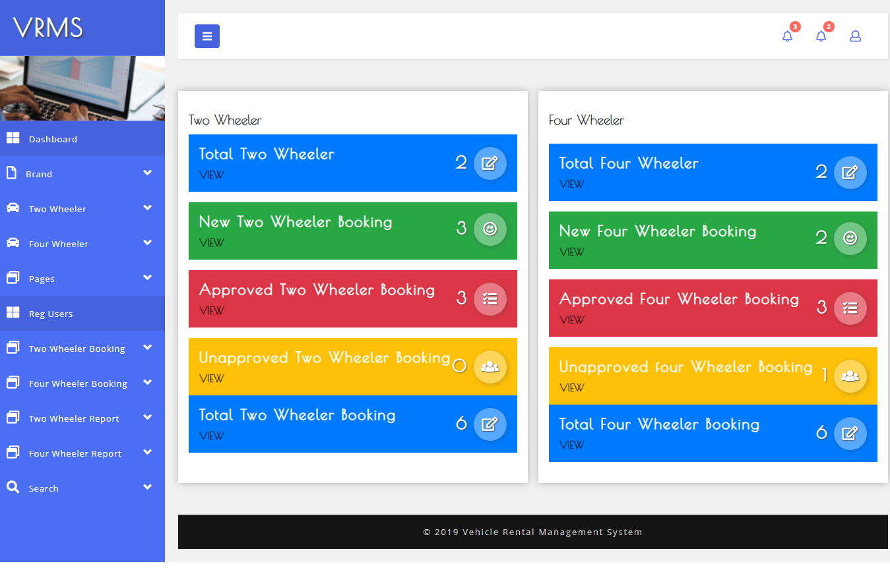
DASHBOARD

Slide 21
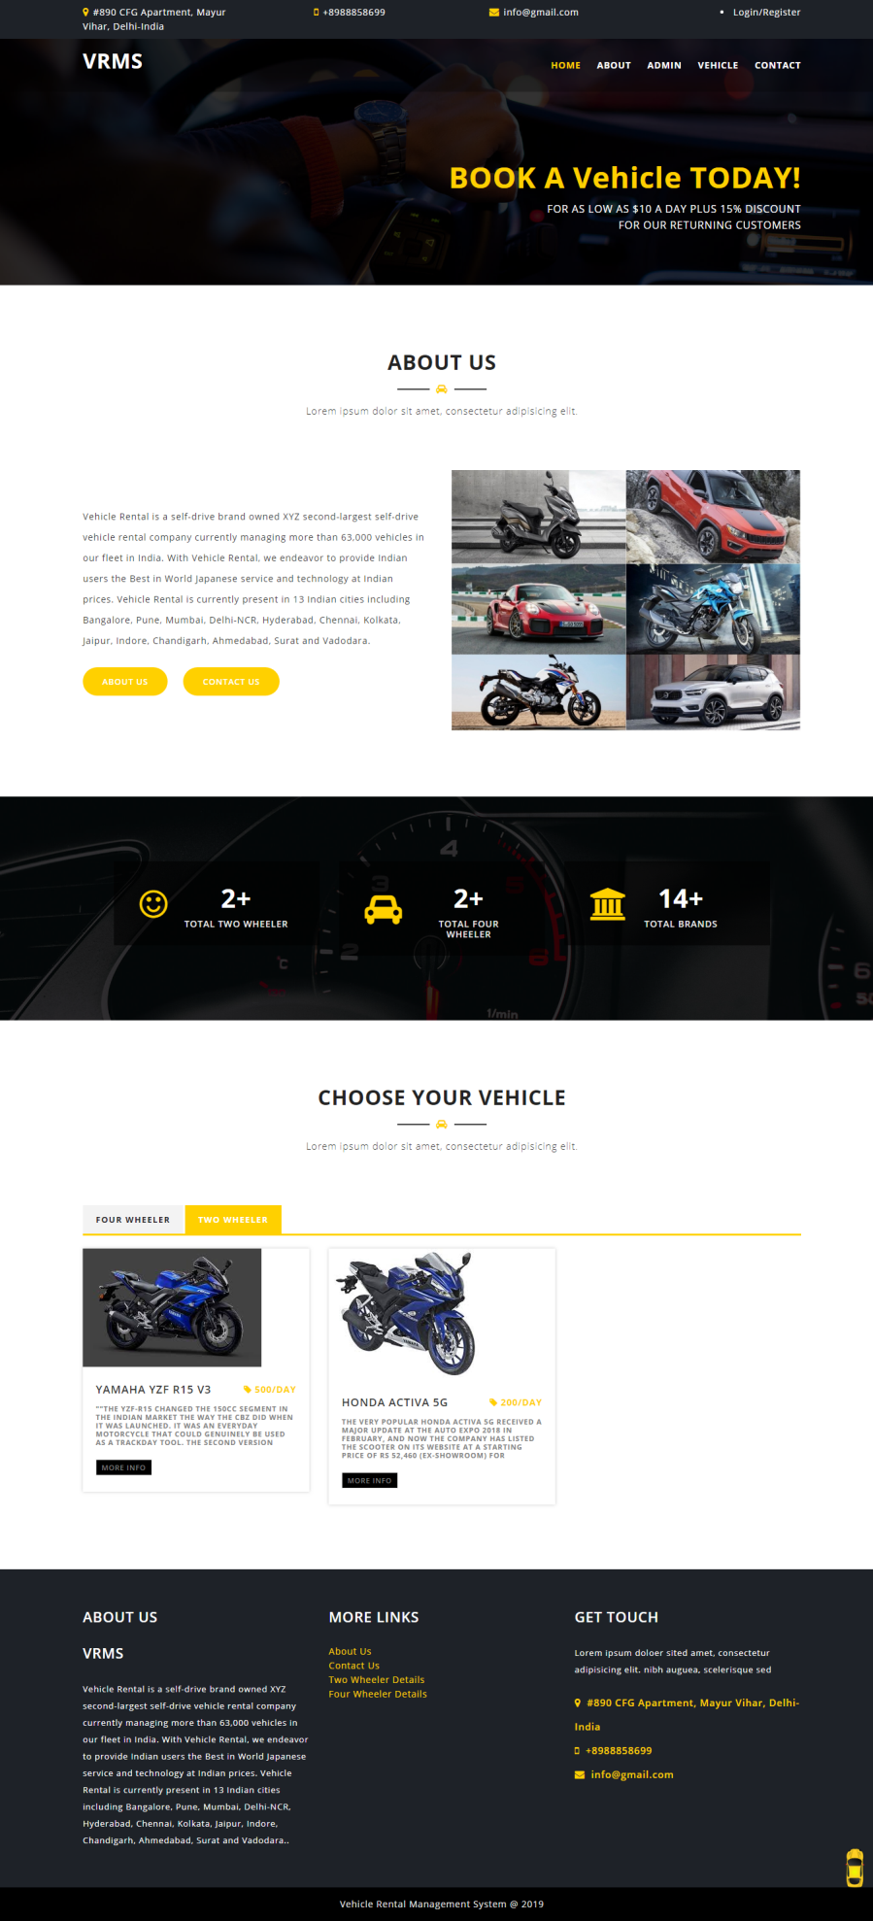
HOME

Slide 22
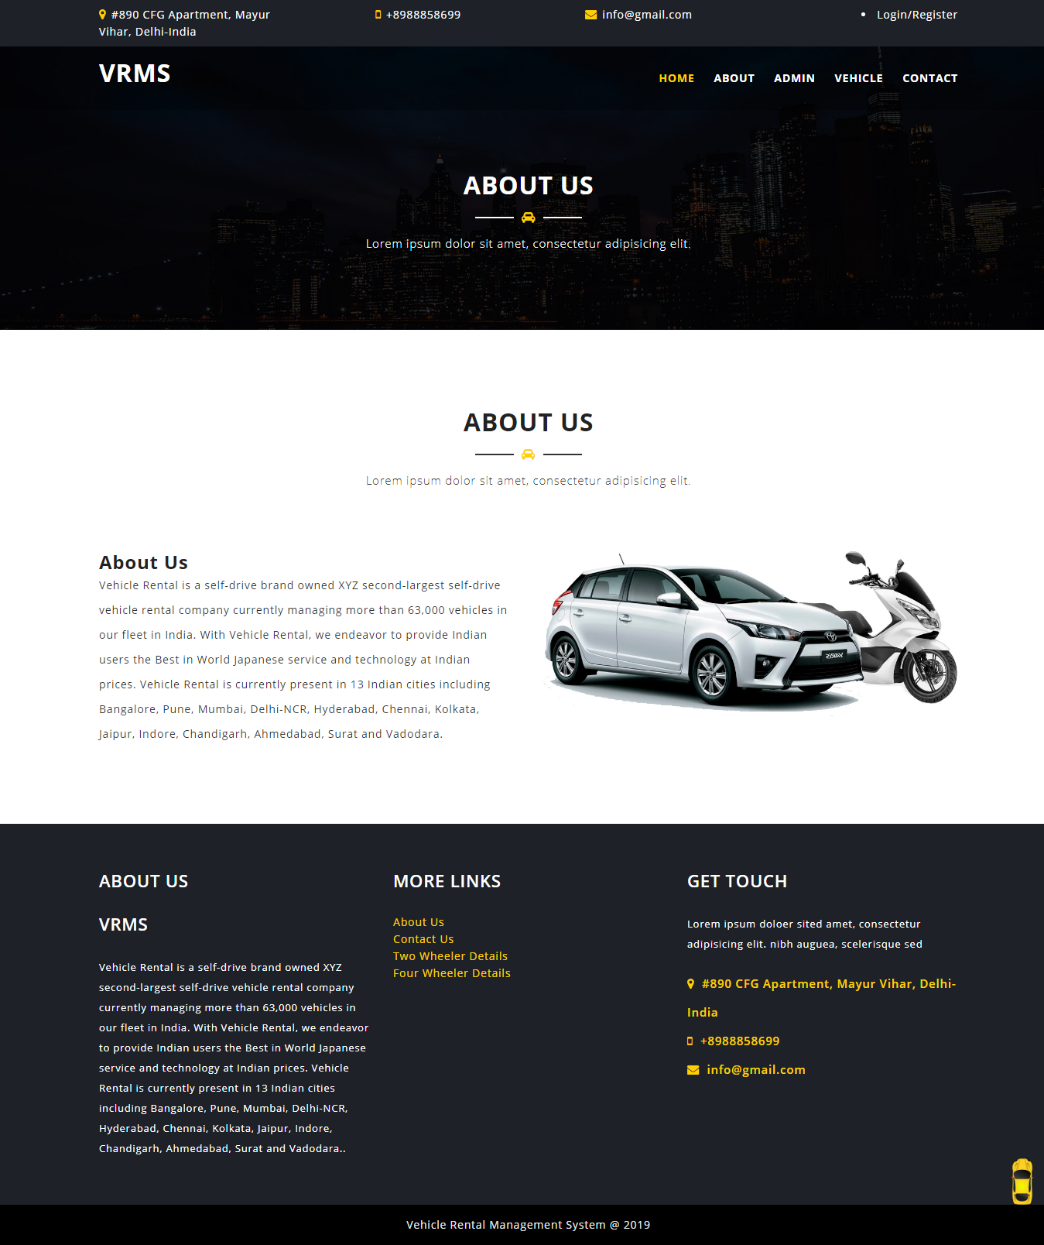
ABOUT US

Slide 23
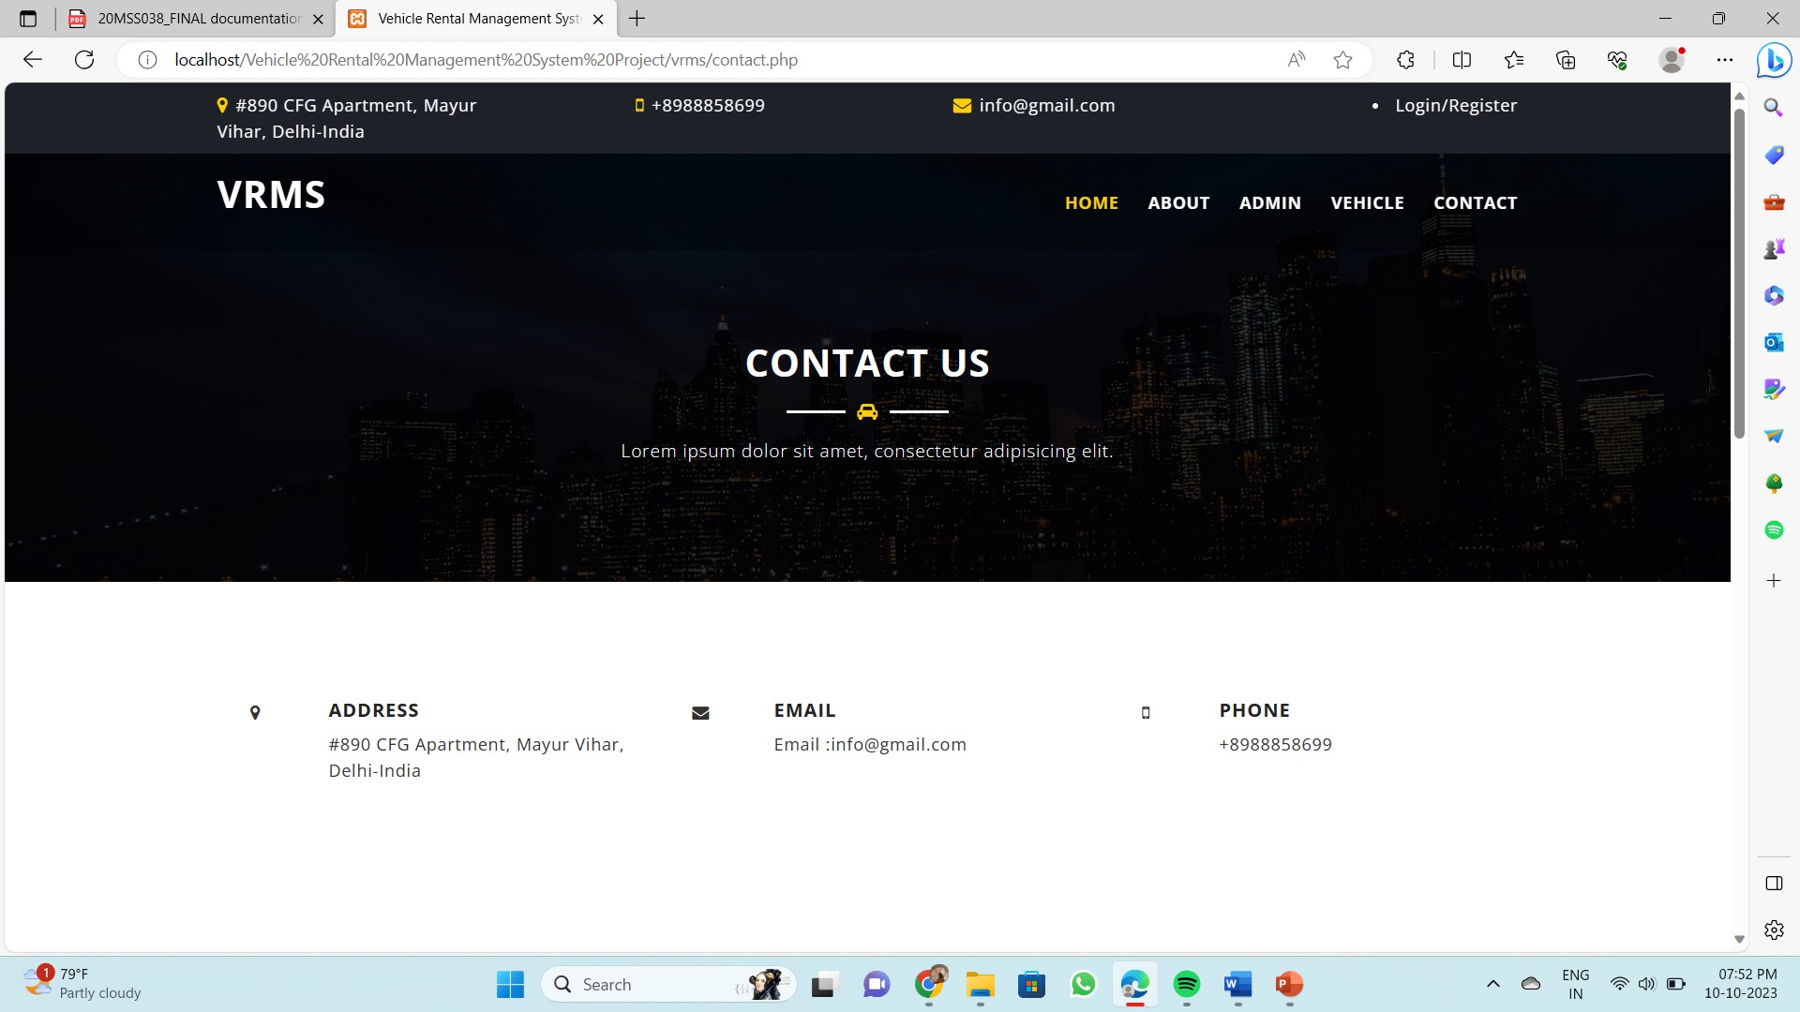
CONTACT US

Slide 24
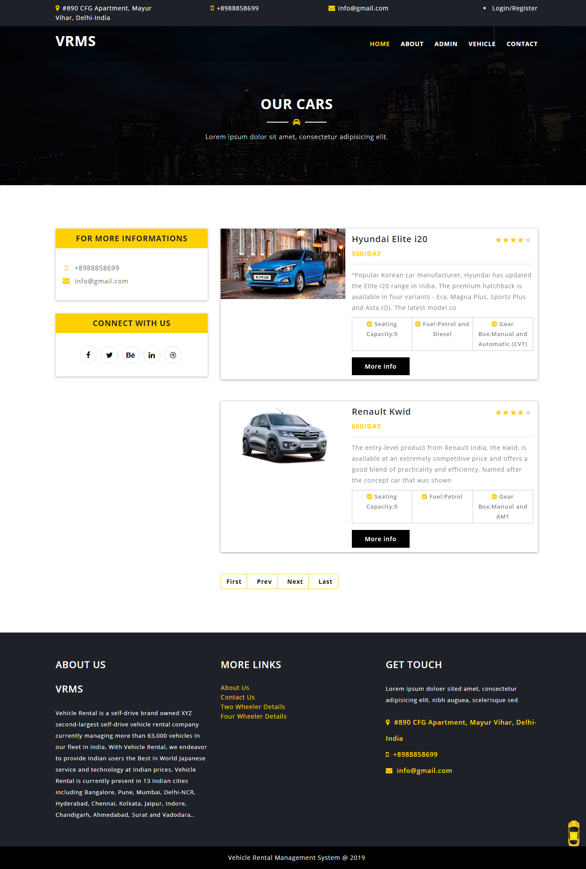
FOUR WHEELER DETAILS

Slide 25
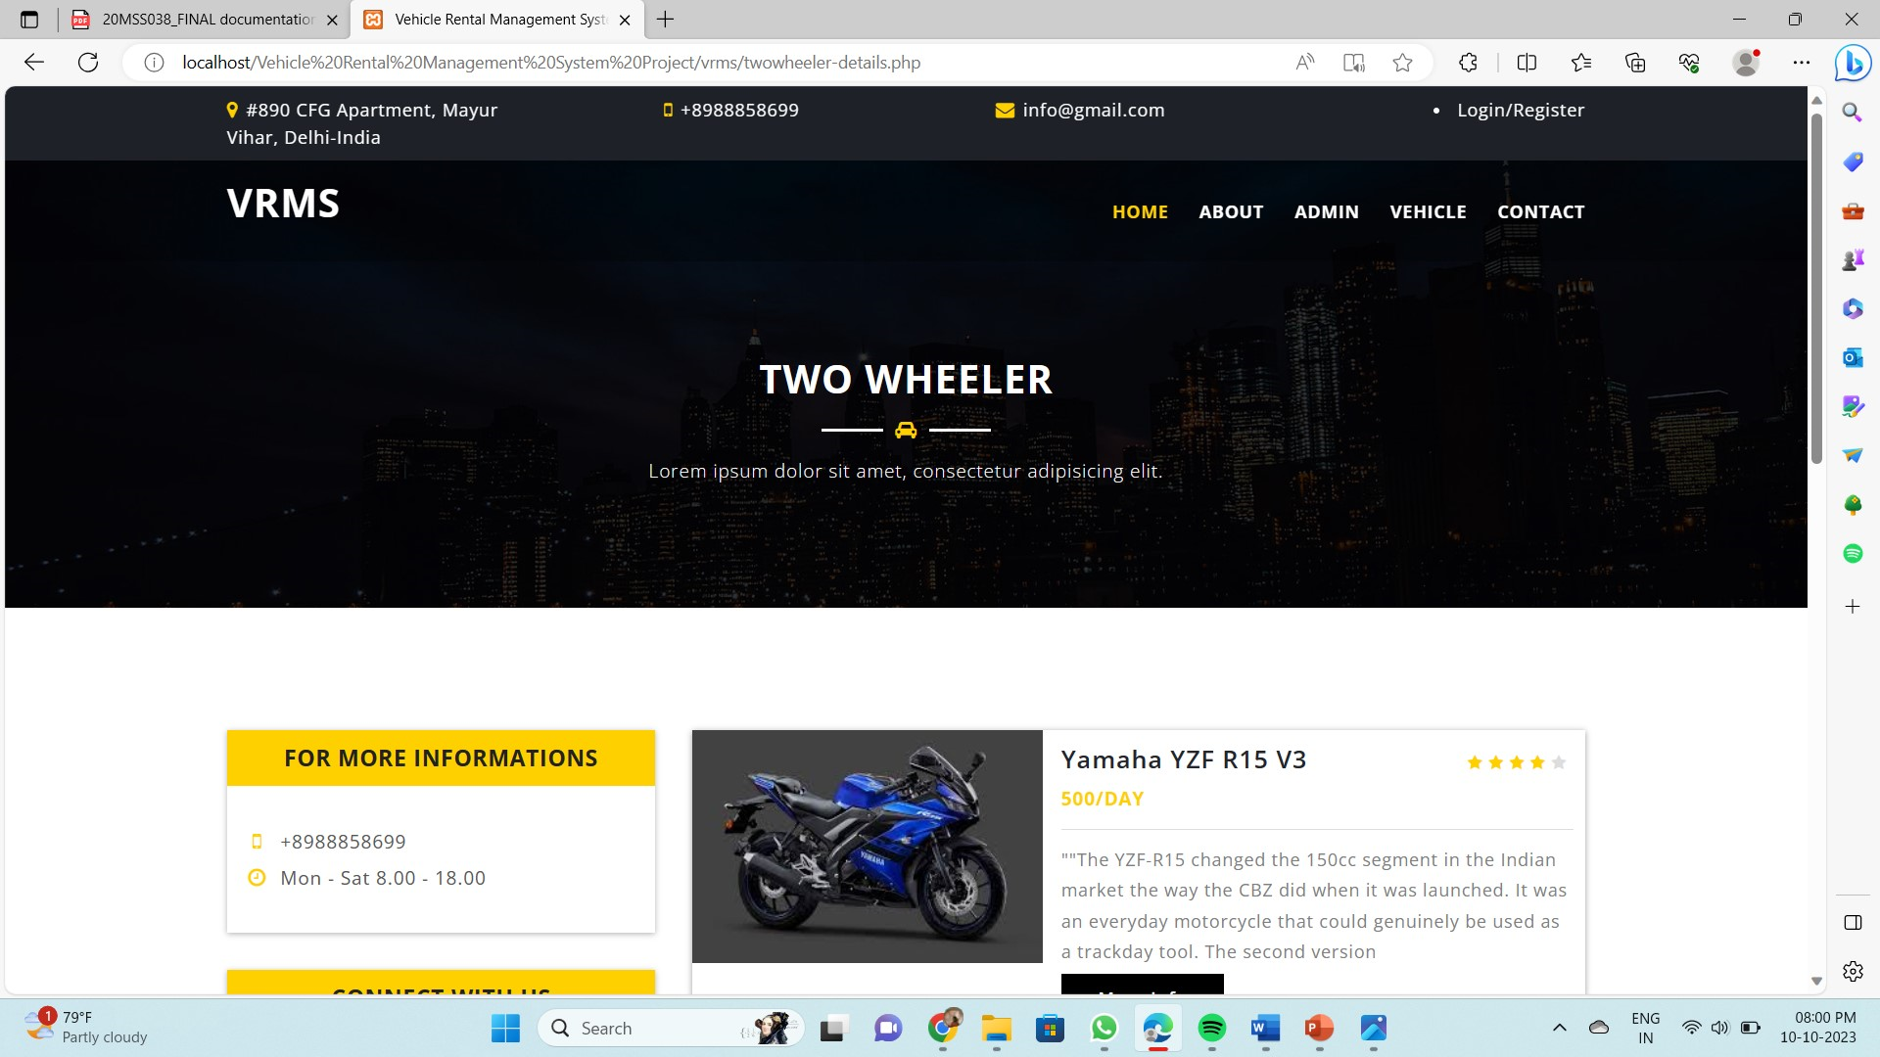
TWO WHEELER DETAILS

Slide 26
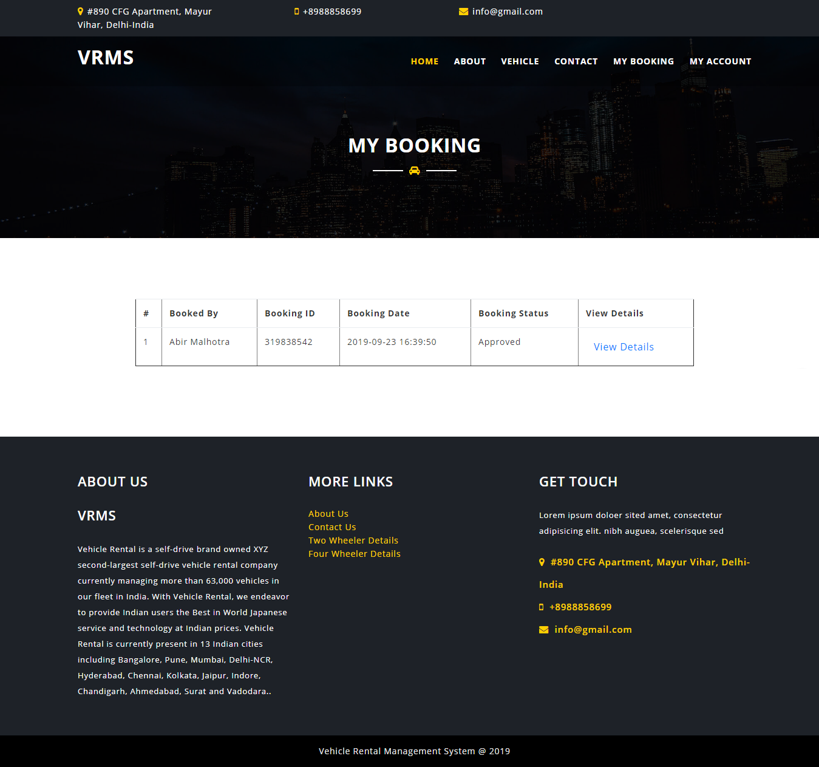
MY BOOKING PAGE

Slide 27
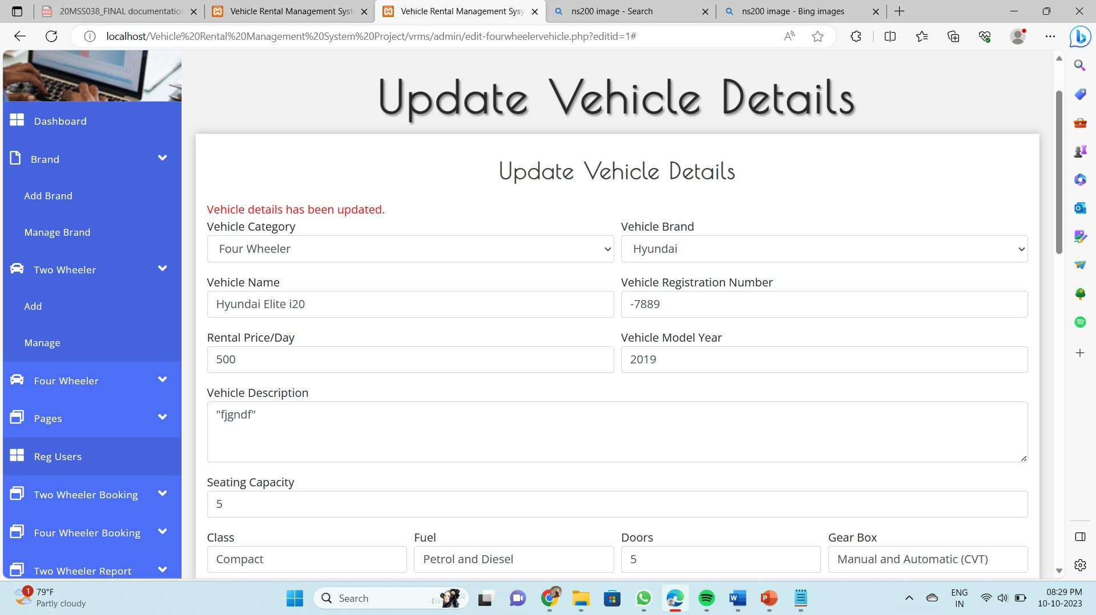
ADD TWO WHEELER

Slide 28
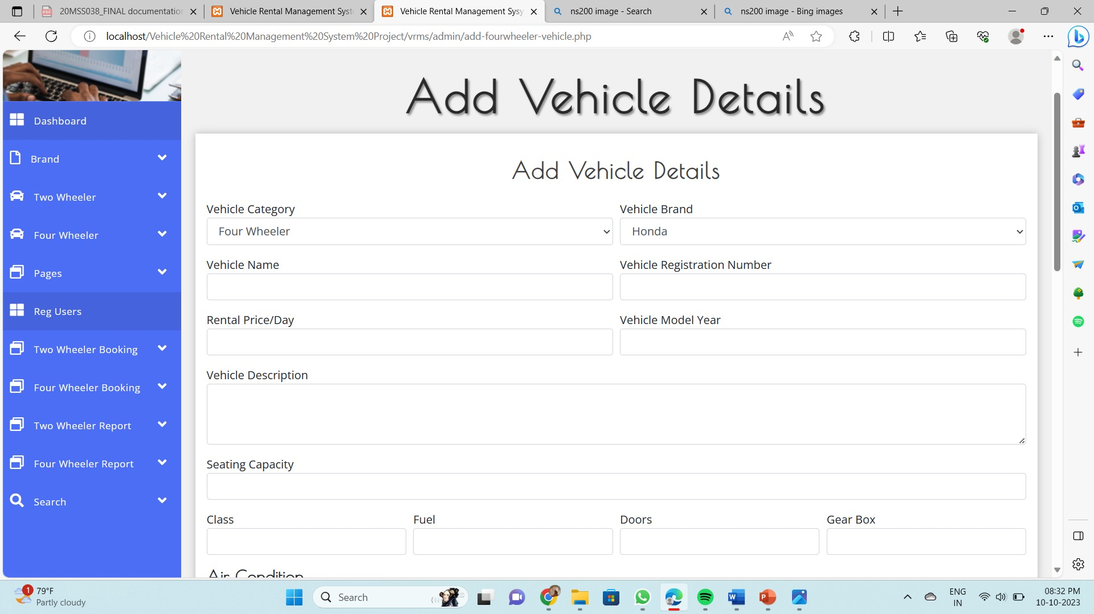
ADD FOUR WHEELER

Slide 29
SCOPE FOR FUTURE ENHANCEMENT
The scope of a vehicle rental website is to provide a convenient and accessible platform for users to rent a wide range of vehicles for various purposes, including personal travel, business trips, and special occasions. This website should offer a user-friendly interface for browsing and selecting vehicles, secure booking and detailed information about vehicle options, pricing, and availability.
The scope also encompasses backend systems for managing vehicle details, handling reservations, and ensuring compliance with regulatory requirements. Overall, the aim is to create a seamless and efficient solution for both customers and the rental business, bridging the gap between vehicle supply and demand in a convenient and cost-effective manner.

Slide 30
CONCLUSION
The project titled “Vehicle Rental Website“ offers a convenient and accessible way for customers to find and book rental vehicles. With a user-friendly interface, a reliable booking system, and clear pricing information, such a website can provide a valuable service to customer.
The platform provides a diverse selection of vehicles, from compact cars to luxury sedans, SUVs, trucks ,sports bikes and super bike allowing users to choose the perfect vehicle to suit their preferences and needs.
By focusing on customer satisfaction, safety, and efficient operations, a vehicle rental website can be a successful venture in the ever-evolving transportation industry.

Slide 31
Thank you

